Slide 1

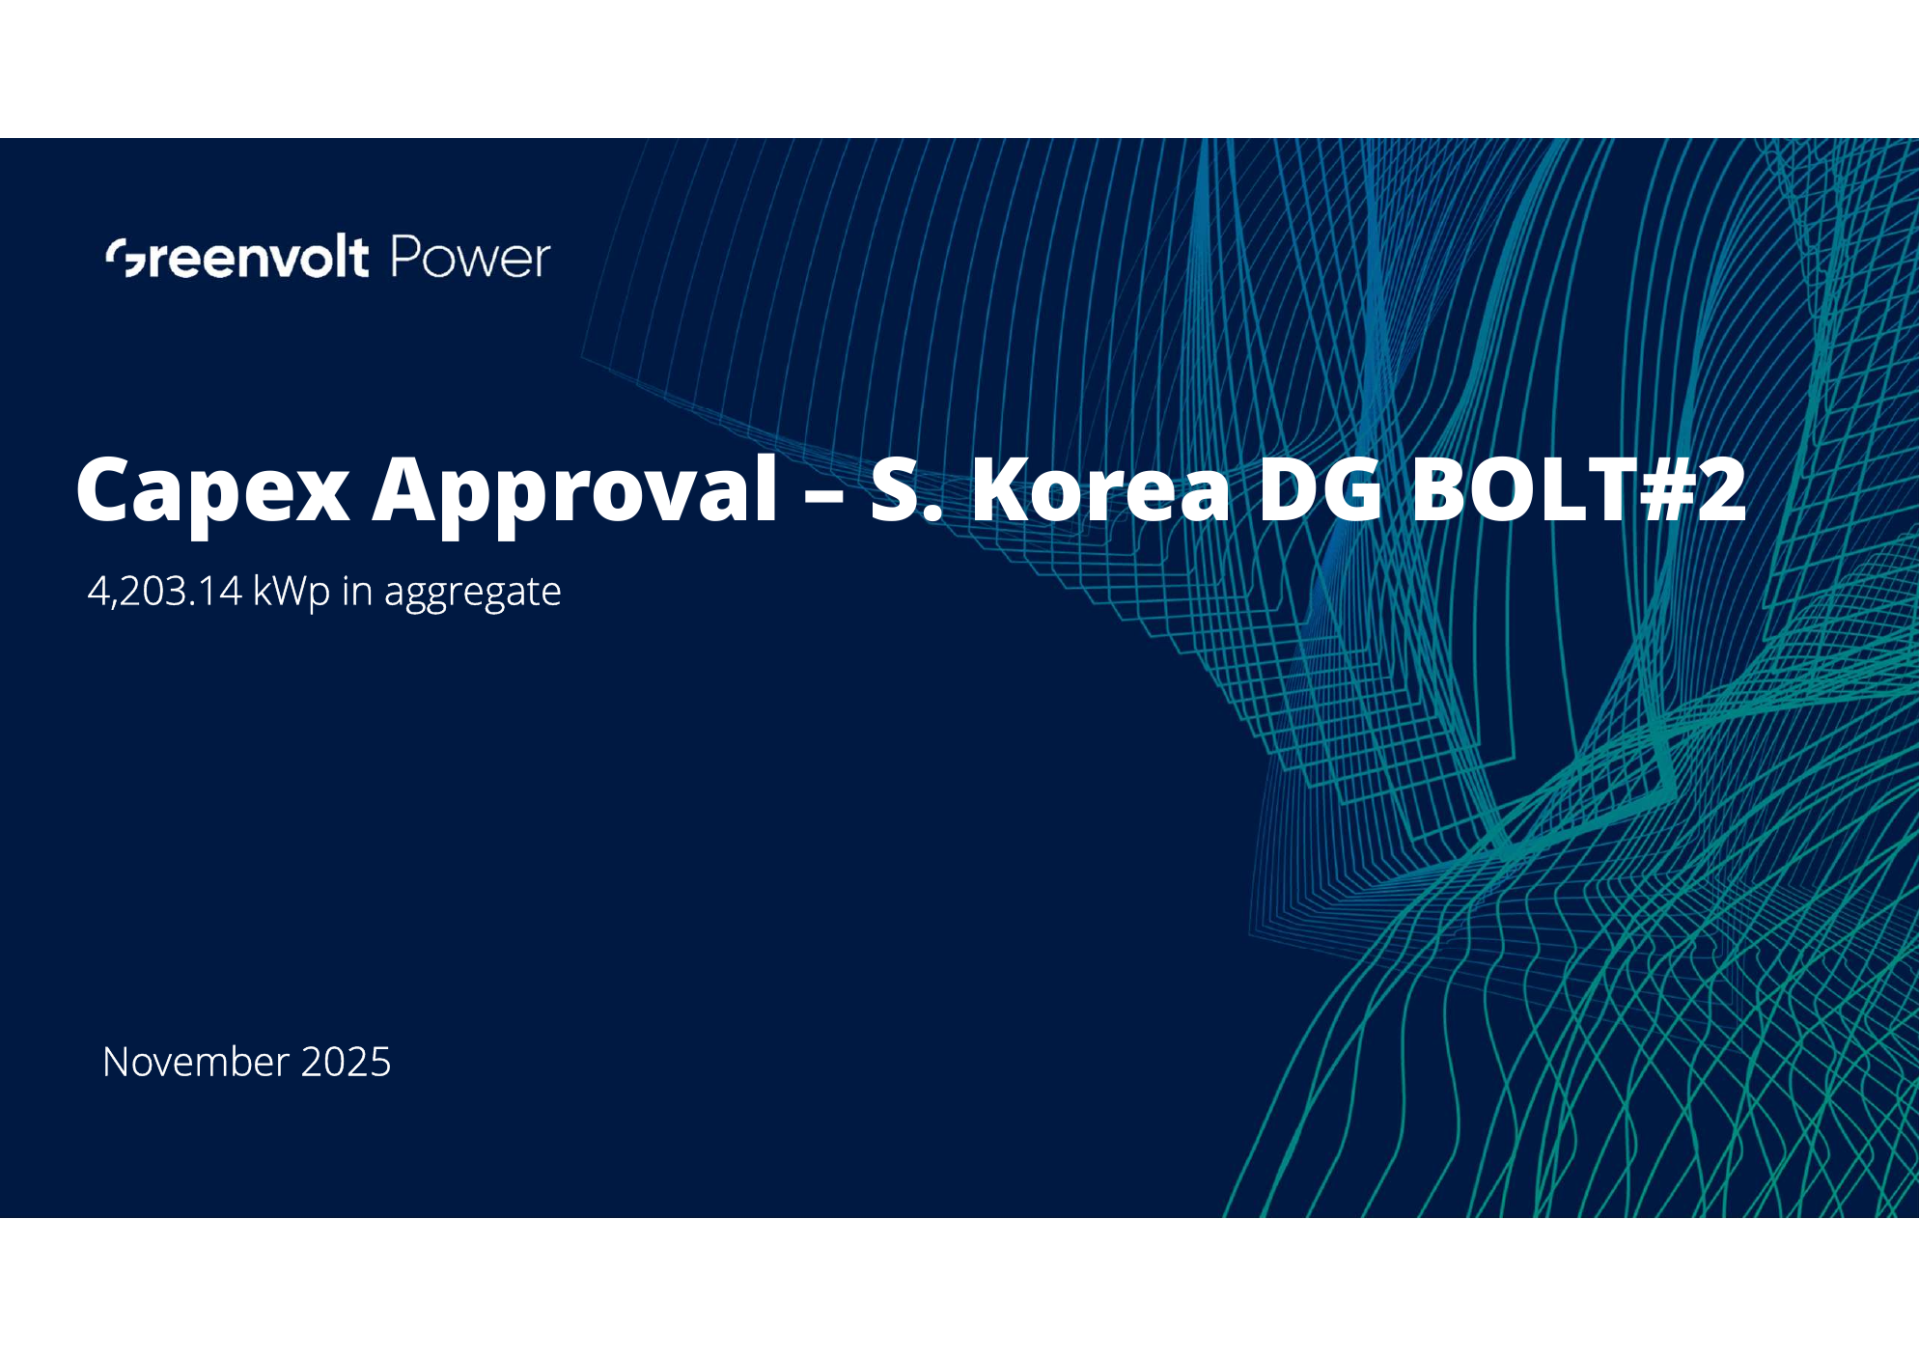
Capex Approval – S. Korea DG BOLT#2
대한민국 분산형 태양광 발전 프로젝트 BOLT #2에 대한 CAPEX 승인 요청---ㅅㄷㅌㅅ

Slide 2
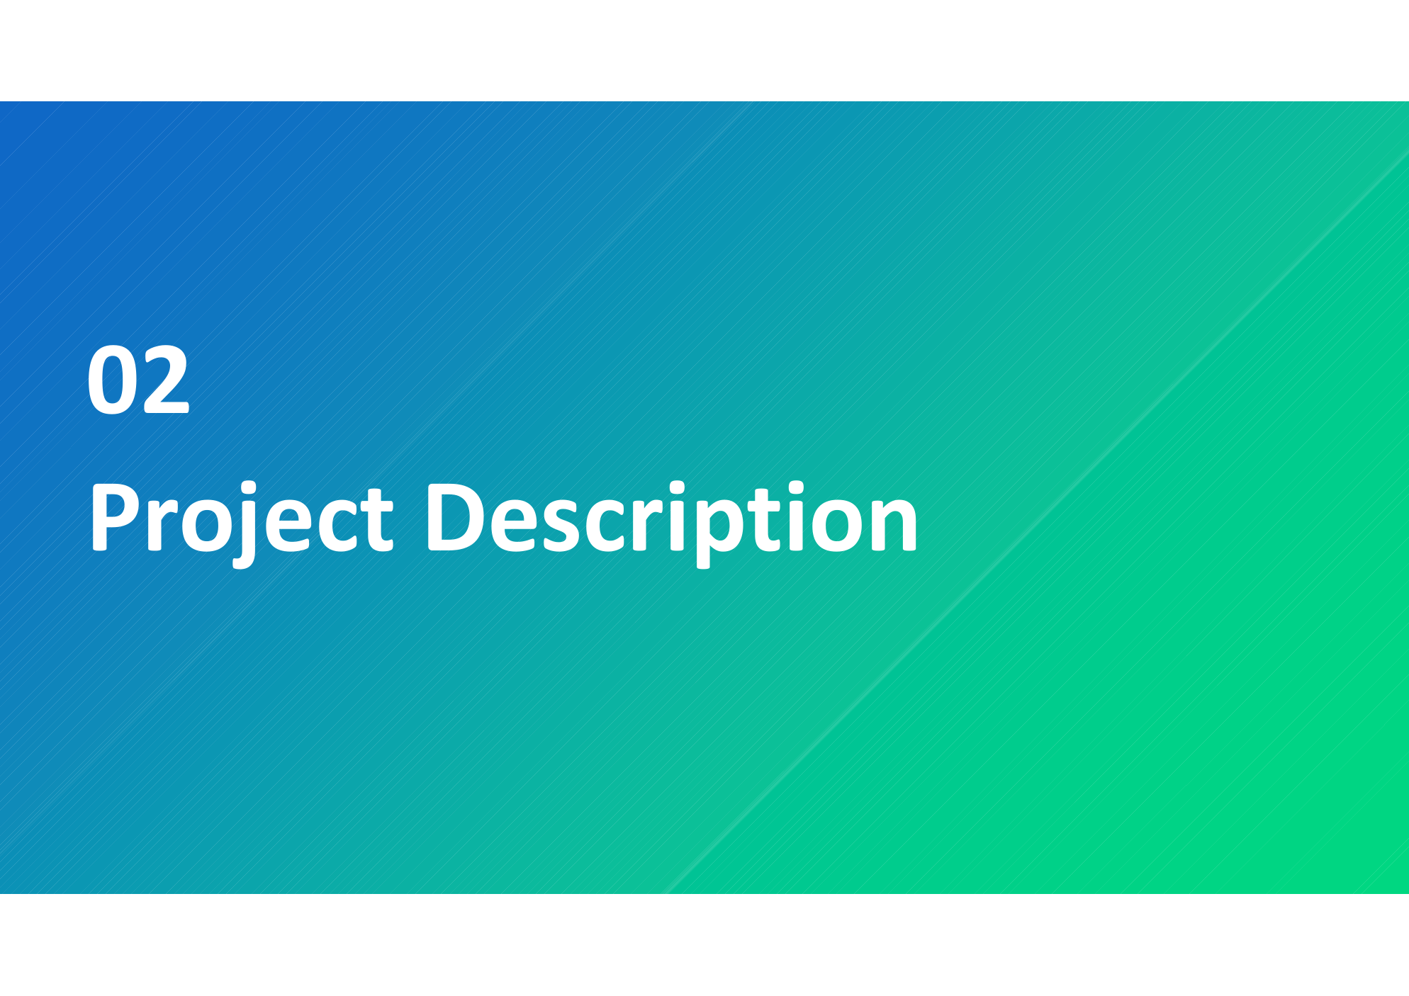
Executive Summary
# | BOLT #2 - Phase 1
1 | RTB 기준 0개 프로젝트, 총 0.00 MWp. 주요 권역: 지역 정보 없음. COD 목표: 데이터 확인 필요. 상태: 데이터 확인 필요. 계통 연계비는 미납 상태이며 COD 이전 CAPEX에서 충당 예정
2 | 상태: RTB 유지, 거래 구조 Ground, 통화 KRW. 계통연계비 CAPEX 지급 가정. REC 단가/수익성 지표는 입력 데이터에 없어 추가 확인 필요
3 | RTB 기준 0개 프로젝트, 총 0.00 MWp. 주요 권역: 지역 정보 없음. COD 목표: 데이터 확인 필요. 상태: 데이터 확인 필요. 계통 연계비는 미납 상태이며 COD 이전 CAPEX에서 충당 예정
4 | 상태: RTB 유지, 거래 구조 Ground, 통화 KRW. 계통연계비 CAPEX 지급 가정. REC 단가/수익성 지표는 입력 데이터에 없어 추가 확인 필요
5 | RTB 기준 0개 프로젝트, 총 0.00 MWp. 주요 권역: 지역 정보 없음. COD 목표: 데이터 확인 필요. 상태: 데이터 확인 필요. 계통 연계비는 미납 상태이며 COD 이전 CAPEX에서 충당 예정
6 | 상태: RTB 유지, 거래 구조 Ground, 통화 KRW. 계통연계비 CAPEX 지급 가정. REC 단가/수익성 지표는 입력 데이터에 없어 추가 확인 필요
7 | 상태: RTB 유지, 거래 구조 Ground, 통화 KRW. 계통연계비 CAPEX 지급 가정. REC 단가/수익성 지표는 입력 데이터에 없어 추가 확인 필요
# | BOLT #2 - Phase 2
1 | 0개 루프탑 PV, 총 0.000 MWp DC, 지역: 지역 정보 없음; COD 목표: 데이터 확인 필요
2 | 상태: EBL 2건, RtB 4건 (입력시트 기준). 계통연계비 CAPEX 포함 가정, REC/수익성 지표는 추가 데이터 확인 필요
3 | 0개 루프탑 PV, 총 0.000 MWp DC, 지역: 지역 정보 없음; COD 목표: 데이터 확인 필요
4 | 상태: EBL 2건, RtB 4건 (입력시트 기준). 계통연계비 CAPEX 포함 가정, REC/수익성 지표는 추가 데이터 확인 필요
5 | 0개 루프탑 PV, 총 0.000 MWp DC, 지역: 지역 정보 없음; COD 목표: 데이터 확인 필요
6 | 상태: EBL 2건, RtB 4건 (입력시트 기준). 계통연계비 CAPEX 포함 가정, REC/수익성 지표는 추가 데이터 확인 필요
7 | 0개 루프탑 PV, 총 0.000 MWp DC, 지역: 지역 정보 없음; COD 목표: 데이터 확인 필요

Slide 3
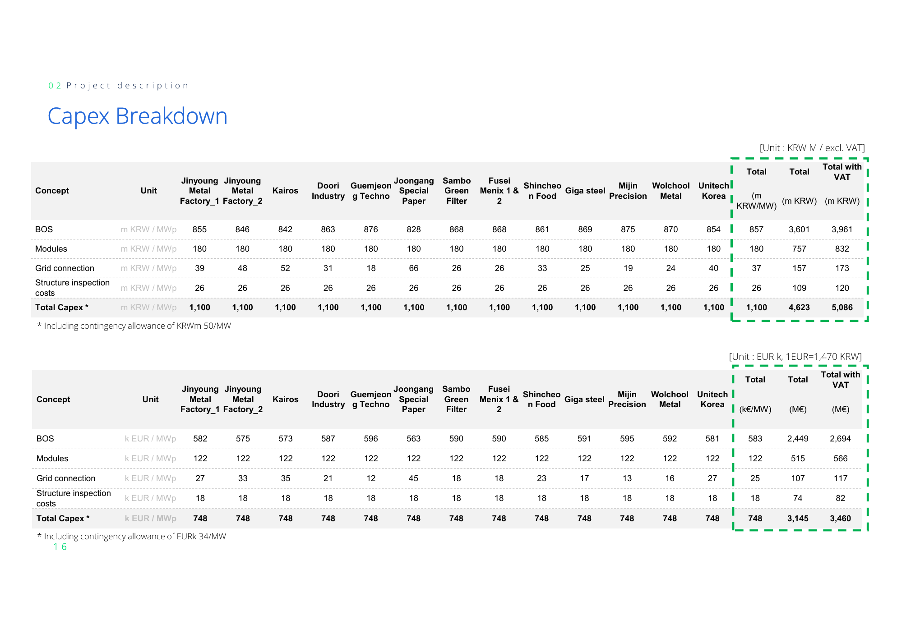
Approval request
Expected return
data
data
CAPEX
3

Slide 4

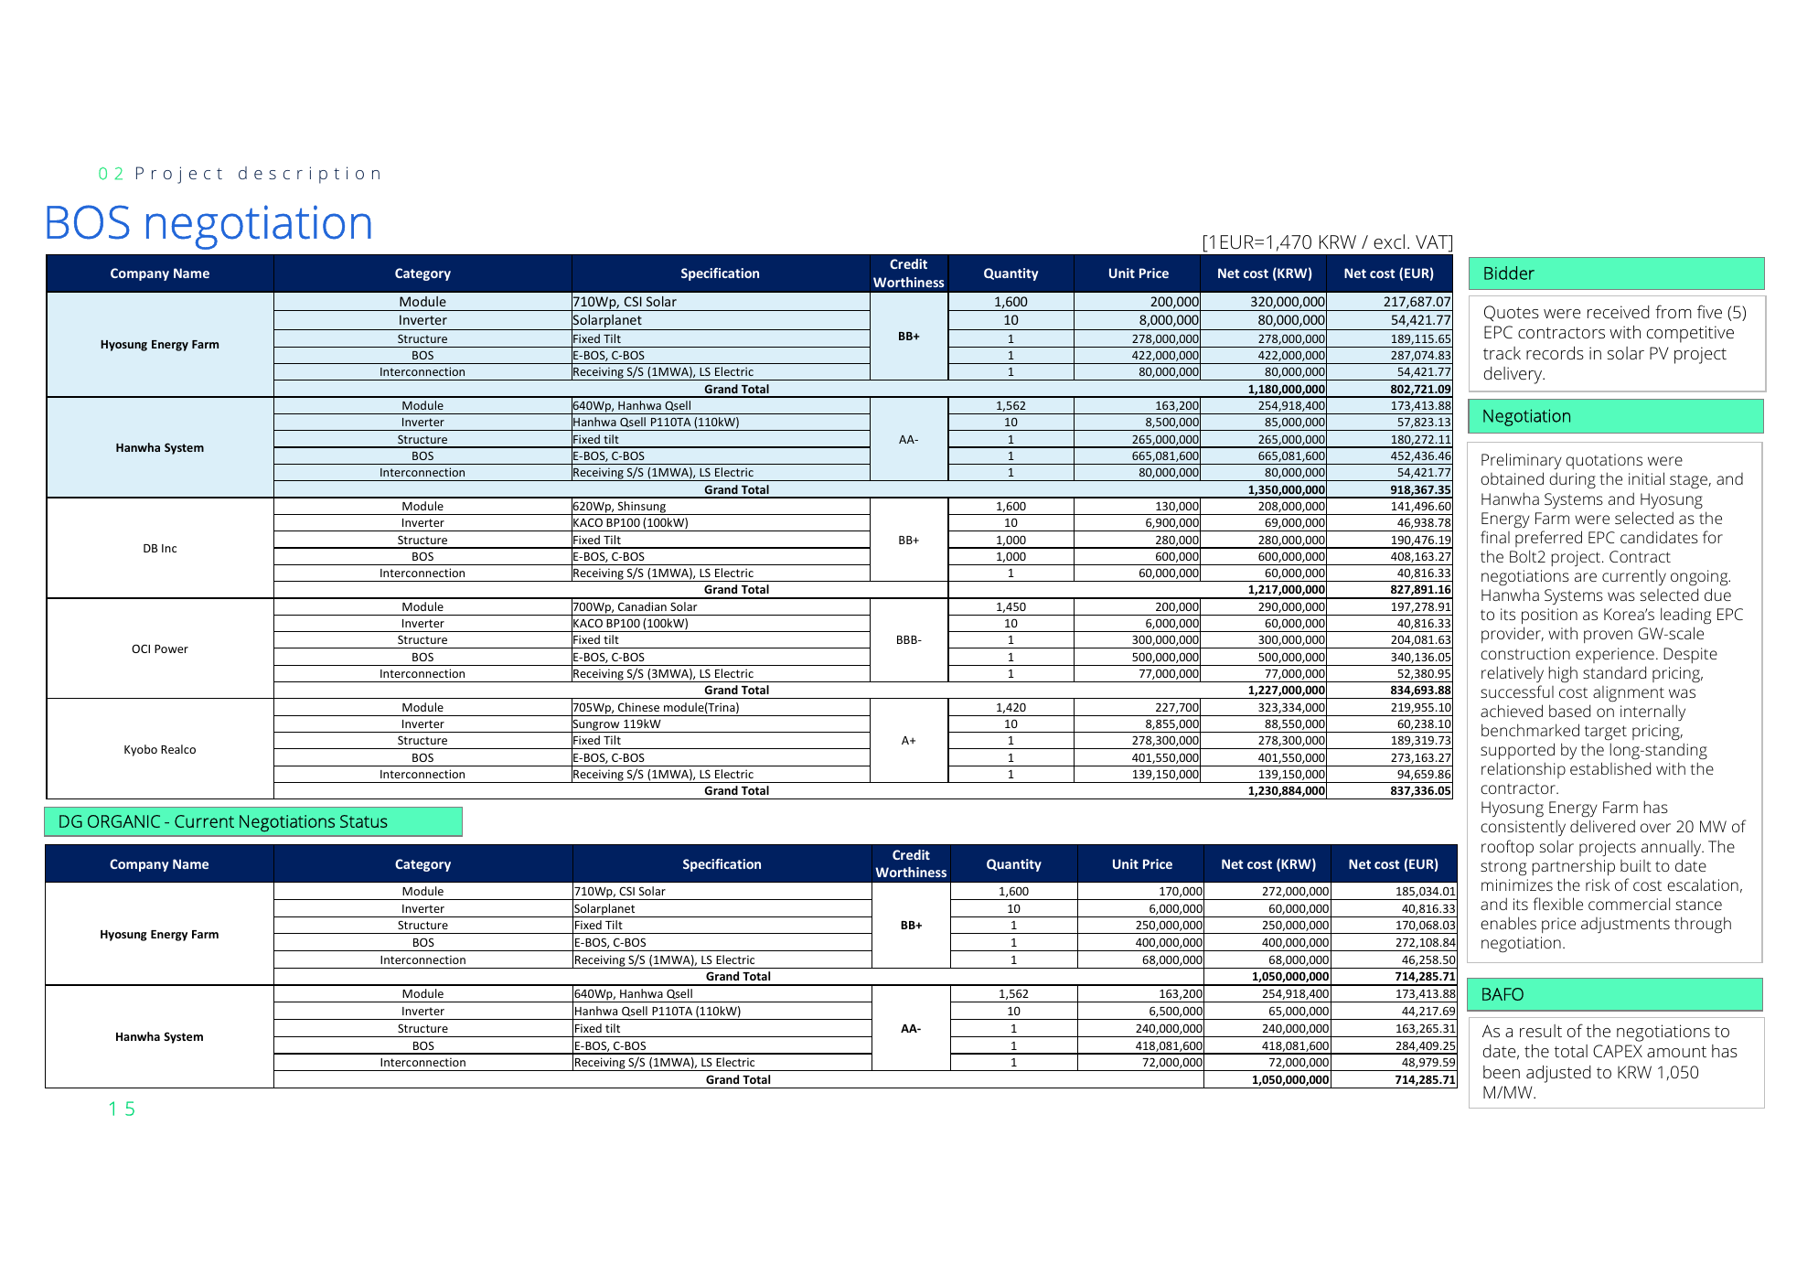
01
Route to Market

Slide 5

Renewable Energy Certificate(REC) Sales Agreement Negotiation
REC sales under discussion with Samcheok Bluepower(SBP) at KRW 189/kWh (20-year fixed term).
SPV | Phase # | No. | PJT Name | Region | Capacity (kWp) | Specific Production (kWh/kWp/yr) | REC Tariff (KRW/kWh) | Offtaker | Status
BOLT#2 | 1 | 1 | Jangchon 1 | Haenam-gun, Jeollanam-do | 551.04 |  |  | SBP (Samcheok Bluepower) | ▪ SBP has confirmed a fixed REC tariff of KRW 189/kWh for a 4.8MW DG portfolio. ▪ OR is currently screening and reviewing candidate projects to be proposed together with the GV PPA. ▪ Upon final selection, the BOLT#2 projects will be formally submitted to SBP, with no change in the agreed pricing.
 |  | 2 | Soltop Masan 1 | Youngdong-gun, Chungcheongbuk-do | 399.04
 |  | 3 | Hanil Mugok 15 | Hapcheon-gun, Gyeongsangnam-do | 499.96
 |  | 4 | Hanil Jigyeong 1 | Youngyang-gun, Gyeongsangbuk-do | 499.96
 |  | 5 | Hanil Jigyeong 2 | Youngyang-gun, Gyeongsangbuk-do | 149.64
 |  | 6 | Ho Duck4 | Goheung-gun, Jeollanam-do | 299.28
 |  | 7 | Galsan Solar | Bonghwa-gun, Gyeongsangbuk-do | 617.76
 |  |  | SubTotal |  | 3,016.68 | 0.00
 | 2 | 8 | Mineuri Solar | Bonghwa-gun, Gyeongsangbuk-do | 564.96
 |  | 9 | Saegol Solar | Bonghwa-gun, Gyeongsangbuk-do | 634.92
 |  | 10 | Jaesan Solar | Bonghwa-gun, Gyeongsangbuk-do | 625.68
 |  |  | SubTotal |  | 1,825.56 | 0.00
 |  |  | TOTAL |  | 4,842.24

Slide 6
02
Project Description

Slide 7
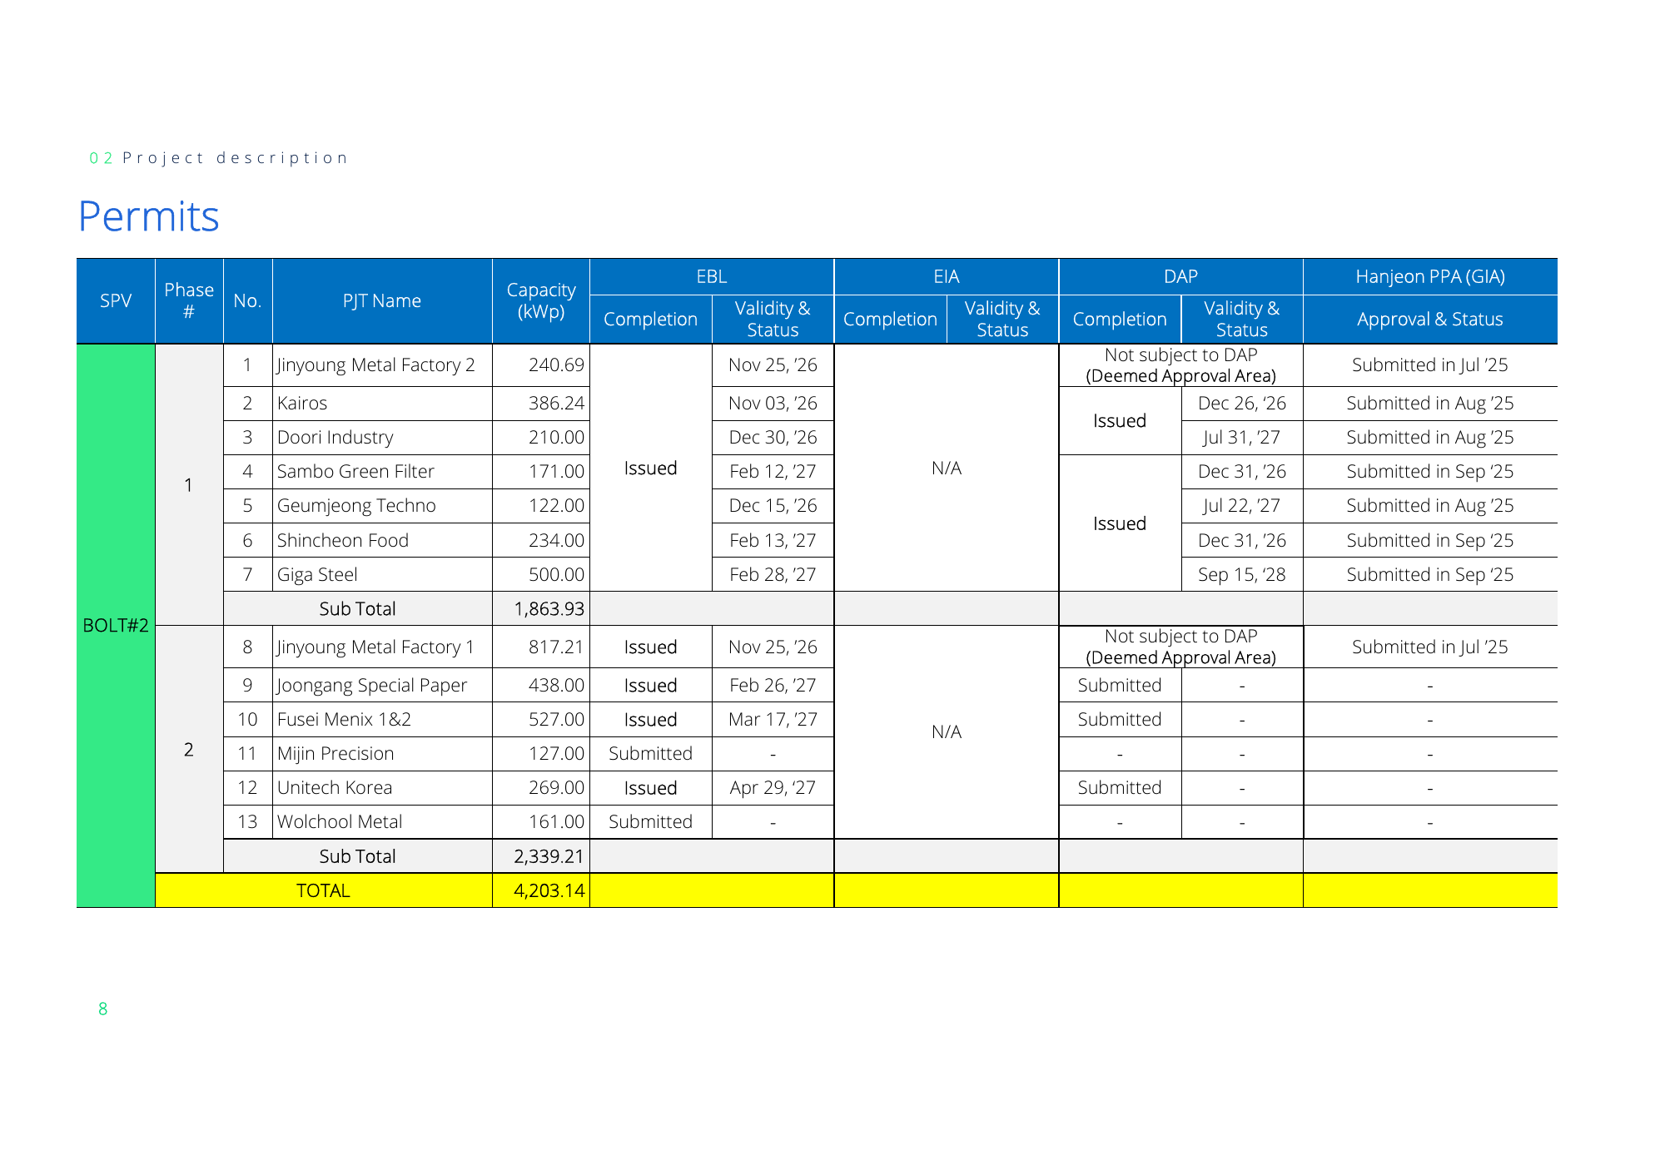
BOLT#2 is Korean PV Portfolio with COD in May-Jun. 2026, Amounting to 4.2MWp
COD 2026 Pipeline
Technical Solution
SPV | Phase # | No. | PJT Name | Region | Capacity (kWp) | COD
BOLT#2 | 1 | 1 | Jangchon 1 | Haenam-gun, Jeollanam-do | 551.04 | May 2026
 |  | 2 | Soltop Masan 1 | Youngdong-gun, Chungcheongbuk-do | 399.04
 |  | 3 | Hanil Mugok 15 | Hapcheon-gun, Gyeongsangnam-do | 499.96
 |  | 4 | Hanil Jigyeong 1 | Youngyang-gun, Gyeongsangbuk-do | 499.96
 |  | 5 | Hanil Jigyeong 2 | Youngyang-gun, Gyeongsangbuk-do | 149.64
 |  | 6 | Ho Duck4 | Goheung-gun, Jeollanam-do | 299.28
 |  | 7 | Galsan Solar | Bonghwa-gun, Gyeongsangbuk-do | 617.76
 |  | Sub Total |  |  | 3,016.68
 | 2 | 8 | Mineuri Solar | Bonghwa-gun, Gyeongsangbuk-do | 564.96 | June 2026
 |  | 9 | Saegol Solar | Bonghwa-gun, Gyeongsangbuk-do | 634.92
 |  | 10 | Jaesan Solar | Bonghwa-gun, Gyeongsangbuk-do | 625.68
 |  | Sub Total |  |  | 1,825.56
 | TOTAL |  |  |  | 4,842.24
Equipment Configuration Summary
Structure
▪ Ground

Slide 8
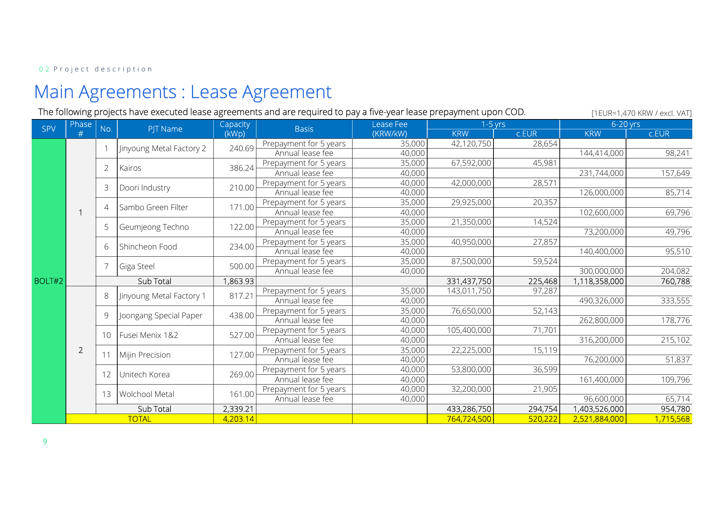
Permits
SPV | Phase # | No. | PJT Name | Capacity (kWp) | EBL Completion | EBL Validity & Status | EIA Completion | EIA Validity & Status | DAP Completion | DAP Validity & Status | Hanjeon PPA (GIA) Approval & Status
BOLT#2 | 1 | 1 | Jangchon 1 | 551.04 |  |  | N/A
 |  | 2 | Soltop Masan 1 | 399.04
 |  | 3 | Hanil Mugok 15 | 499.96
 |  | 4 | Hanil Jigyeong 1 | 499.96
 |  | 5 | Hanil Jigyeong 2 | 149.64
 |  | 6 | Ho Duck4 | 299.28
 |  | 7 | Galsan Solar | 617.76
 |  | Sub Total
 | 2 | 8 | Mineuri Solar | 564.96
 |  | 9 | Saegol Solar | 634.92
 |  | 10 | Jaesan Solar | 625.68
 |  | Sub Total
 |  | TOTAL

Slide 9
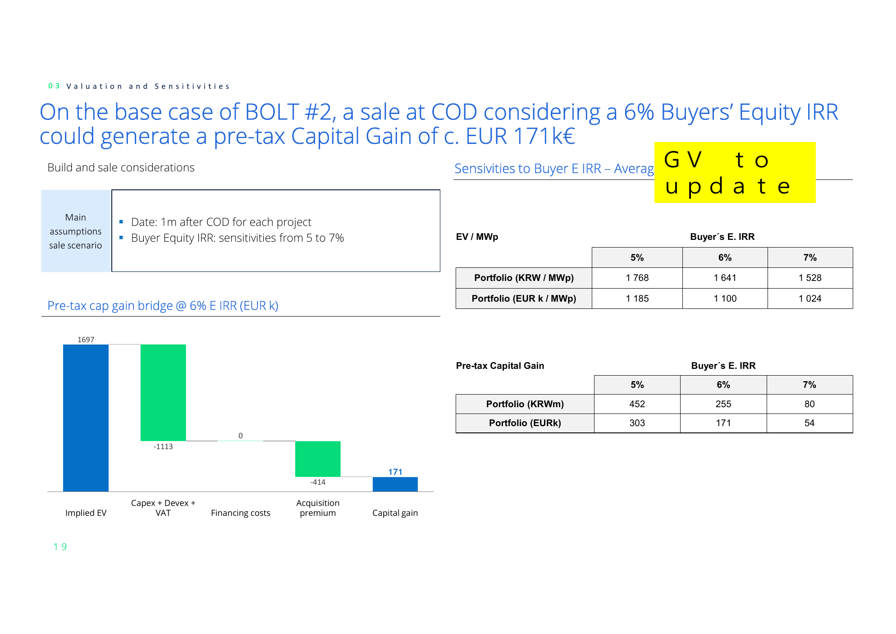
Main Agreements : Lease Agreement
SPV | Phase # | No. | PJT Name | Capacity (kWp) | Basis | Lease Fee (KRW/kW) | 1-5 yrs KRW | 1-5 yrs c.EUR | 6-20 yrs KRW | 6-20 yrs c.EUR
BOLT#2 | 1 | 1 | Jangchon 1 | 551.04 | Prepayment for 5 years | 35,000 | 19,286,400 | 13,120
 |  |  |  |  | Annual lease fee | 40,000 |  |  | 22,041,600 | 14,994
 | 1 | 2 | Soltop Masan 1 | 399.04 | Prepayment for 5 years | 35,000 | 13,966,400 | 9,501
 |  |  |  |  | Annual lease fee | 40,000 |  |  | 15,961,600 | 10,858
 | 1 | 3 | Hanil Mugok 15 | 499.96 | Prepayment for 5 years | 35,000 | 17,498,600 | 11,904
 |  |  |  |  | Annual lease fee | 40,000 |  |  | 19,998,400 | 13,604
 | 1 | 4 | Hanil Jigyeong 1 | 499.96 | Prepayment for 5 years | 35,000 | 17,498,600 | 11,904
 |  |  |  |  | Annual lease fee | 40,000 |  |  | 19,998,400 | 13,604
 | 1 | 5 | Hanil Jigyeong 2 | 149.64 | Prepayment for 5 years | 35,000 | 5,237,400 | 3,563
 |  |  |  |  | Annual lease fee | 40,000 |  |  | 5,985,600 | 4,072
 | 1 | 6 | Ho Duck4 | 299.28 | Prepayment for 5 years | 35,000 | 10,474,800 | 7,126
 |  |  |  |  | Annual lease fee | 40,000 |  |  | 11,971,200 | 8,144
 | 1 | 7 | Galsan Solar | 617.76 | Prepayment for 5 years | 35,000 | 21,621,600 | 14,709
 |  |  |  |  | Annual lease fee | 40,000 |  |  | 24,710,400 | 16,810
 |  |  | Sub Total | 3,016.68 |  |  | 105,583,800 | 71,826 | 120,667,200 | 82,087
 | 2 | 8 | Mineuri Solar | 564.96 | Prepayment for 5 years | 35,000 | 19,773,600 | 13,451
 |  |  |  |  | Annual lease fee | 40,000 |  |  | 22,598,400 | 15,373
 | 2 | 9 | Saegol Solar | 634.92 | Prepayment for 5 years | 35,000 | 22,222,200 | 15,117
 |  |  |  |  | Annual lease fee | 40,000 |  |  | 25,396,800 | 17,277
 | 2 | 10 | Jaesan Solar | 625.68 | Prepayment for 5 years | 35,000 | 21,898,800 | 14,897
 |  |  |  |  | Annual lease fee | 40,000 |  |  | 25,027,200 | 17,025
 |  |  | Sub Total | 1,825.56 |  |  | 63,894,600 | 43,466 | 73,022,400 | 49,675
 |  |  | TOTAL | 4,842.24 |  |  | 169,478,400 | 115,291 | 193,689,600 | 131,762

Slide 10



Main Agreements : EPC, REC Sales Agreement, O&M
Agreement
Completion
Current Status
Next Steps
• The bulk EPC contract value is set at KRW 1,050 million per MW (approx. EUR 714k), inclusive of contingency KRW 3.9 million per MW.
• Contractual conditions review status to be confirmed.
• Contracts with EPC contractor allocation pending (10 projects) are scheduled for signature in TBD.
• GPK's execution of the agreement shall follow CAPEX approval (KRW 8,514M / EUR 5,791,558 for 4.842MWp) and the contractor's signing of the EPC contract.
Contractor
EPC Contract
Signature
Pending
• Under discussion with Offtaker to be confirmed (TBD, RPS obligor) for a TBD-year REC Sales Agreement at a fixed price of KRW 189/kWh.
• The price offer remains valid until end of 2026; management approval is pending prior to contract execution.
• Complete management approval and proceed to REC Sales Agreement execution with TBD.
REC Sales
On-going
Agreement
Review
• OR has conducted an RfP for O&M providers.
• O&M commercial benchmark is KRW 12,500,000/MW and remains in line with profitability modelling; vendor selection will prioritize penalties for non-compliance track records.
• Current leading candidate: to be confirmed.
• Following Greenvolt's review/comments (pending review and comments), the selected vendor will proceed under the same terms and conditions.
O&M
On-going
Review

Slide 11
Project Construction Plan_Phase 1
SN
Description
Feb 2026
Mar 2026
Apr 2026
May 2026
Jun 2026
Jul 2026
1w
2w
3w
4w
1w
2w
3w
4w
1w
2w
3w
4w
1w
2w
3w
4w
1w
2w
3w
4w
1w
1
Due Diligence
Technical DD – Final review
2
Detailed Design of Power Plant
Detailed Design of Power Plant
3
Material approval
Material approval
4
Material Purchase
Material Purchase
Structure (4 weeks)
5
Structures Working
Module on-site receipt
Module Installation
6
Electrical work
Electrical work
Grid connection work (KEPCO)
Commissioning & pre-use inspections

Slide 12
Project Construction Plan_Phase 2
SN
Description
Feb 2026
Mar 2026
Apr 2026
May 2026
Jun 2026
Jul 2026
1w
2w
3w
4w
1w
2w
3w
4w
1w
2w
3w
4w
1w
2w
3w
4w
1w
2w
3w
4w
1w
1
Due Diligence
Technical DD – Final review
2
Detailed Design of Power Plant
Detailed Design of Power Plant
3
Material approval
Material approval
4
Material Purchase
Material Purchase
Structure (4 weeks)
5
Structures Working
Module on-site receipt
Module Installation
6
Electrical work
Electrical work
Grid connection work (KEPCO)
Commissioning & pre-use inspections

Slide 13
Construction Planning - BOLT#2 Phase1,2
SPV | Phase # | No. | PJT Name | Capacity (kWp) | RtB Date | Expected SOC | Expected COD
BOLT#2 | 1 | 1 | Jangchon 1 | 551.04 | May 01, '26 | Jul 01, '26 | Oct 01, '26
 |  | 2 | Soltop Masan 1 | 399.04 | May 01, '26 | Jul 01, '26 | Oct 01, '26
 |  | 3 | Hanil Mugok 15 | 499.96 | May 01, '26 | Jul 01, '26 | Oct 01, '26
 |  | 4 | Hanil Jigyeong 1 | 499.96 | May 01, '26 | Jul 01, '26 | Oct 01, '26
 |  | 5 | Hanil Jigyeong 2 | 149.64 | May 01, '26 | Jul 01, '26 | Oct 01, '26
 |  | 6 | Ho Duck4 | 299.28 | May 01, '26 | Jul 01, '26 | Oct 01, '26
 |  | 7 | Galsan Solar | 617.76 | Sep 01, '26 | Nov 01, '26 | Feb 01, '27
 |  | Sub Total |  | 3,016.68
 | 2 | 8 | Mineuri Solar | 564.96 | Sep 01, '26 | Nov 01, '26 | Feb 01, '27
 |  | 9 | Saegol Solar | 634.92 | Sep 01, '26 | Nov 01, '26 | Feb 01, '27
 |  | 10 | Jaesan Solar | 625.68 | Sep 01, '26 | Nov 01, '26 | Feb 01, '27
 |  | Sub Total |  | 1,825.56
 | TOTAL
Engineering (Phase 1,2)
▪ Phase 1: 7 projects, 3,016.68 kWp, RTB window May 2026 - Sep 2026.
▪ Phase 2: 3 projects, 1,825.56 kWp, RTB window Sep 2026.
Procurement (Phase 1,2)
▪ Phase 1: SOC window Jul 2026 - Nov 2026 for procurement readiness.
▪ Phase 2: SOC window Nov 2026 for procurement readiness.
Construction (Phase 1,2)
▪ Phase 1: COD window Oct 2026 - Feb 2027.
▪ Phase 2: COD window Feb 2027.
▪ Portfolio baseline: 4,842.24 kWp across 10 projects.

Slide 14
Equipment procurement process – Illustrative case
• Each cluster set is assessed with representative capacity around 484kW (range 150-635kW).
• Target procurement pricing baseline is set for the 2026 COD pipeline covering 10 projects.
• Equipment standardization baseline includes 1 panel model(s) and approximately 0 modules across the portfolio.
• Current procurement cost benchmark is about KRW 1,050.0m/MW (Modules 180.0m, BOS 800.0m, Grid 70.0m).
• Contingency allowance is tracked at KRW 3.9m/MW and remains a key buffer against supplier-side price movement.
• All values remain subject to ongoing supplier negotiations and periodic cost refresh cycles.
PROJECT DETAIL, 1000kWp
CUBICLE [1200kVA]+'DER-AVM'+PV MONITORING
INVERTER [100kW] * 10SET/11SET
PANELS [635W]
CIVIL ENG+STRUCTURE + FENCE
CCTV(include POE System)
CLUSTER
CLUSTER SET 1 ~ 4
Company
Amount(\)
Won(\)/wp
Company
Amount(\)
Won(\)/wp
Company
Amount(\)
Won(\)/wp
Company
Amount(\)
Won(\)/wp
Company
Amount(\)
Won(\)/wp
LOCATION
see the LOCATION
Budget
70,000,000
70.0
Budget
Budget
Budget
Budget
CLUSTER
COD
Q4 26
DCNCA
Solarplanet
CSI solar
DCNCA
IDIS
SET
DC WP
1,950
Hyundai
Hanhwa Qcell
JASOLAR
DG ENC
AURA
1 ~4
TOTAL Quote((\)
HanaEng.
hwawei
Hanhwa Qcell
Aju Steel
YOUNGDO
Equip. Budget(\)
2,055,105,000
Δ+
7,605,000
TOTAL Quote(\) is included Constructions/Install/Engineering and Wiring
2,047,500,000
LS Sauter / 1MW
OCI Power / 1MW
SHINSUNG E&G / 1MW
Module
KRWm/MWp
USD/kWp
Module
KRWm/MWp
USD/kWp
Module
KRWm/MWp
USD/kWp
Inverter
* structure costs included
Inverter
Inverter
* structure costs included into
BOS
Structure
into BOS
BOS
Structure
BOS
Structure
BOS
E-BOS, C-BOS
E-BOS, C-BOS
E-BOS, C-BOS
Interconnection
Lump sum
Interconnection
Lump sum
Interconnection
Lump sum
Net Total (BOS)
Net Total (BOS)
Net Total (BOS)
G. Total (BOS) adding 10%
G. Total (BOS) adding 10%
G. Total (BOS) adding 10%
overhead
overhead
overhead
Hanhwa system / 1MW
HSEF / 1MW
Kumyang Green Power / 1MW
Module
KRWm/MWp
USD/kWp
Module
KRWm/MWp
USD/kWp
Module
KRWm/MWp
USD/kWp
Inverter
Inverter
Inverter
* structure costs included into
BOS
Structure
BOS
Structure
BOS
Structure
BOS
E-BOS, C-BOS
E-BOS, C-BOS
E-BOS, C-BOS
Interconnection
Lump sum
Interconnection
Lump sum
Interconnection
Lump sum
Net Total (BOS)
Net Total (BOS)
Net Total (BOS)
G. Total (BOS) adding 10%
G. Total (BOS) adding 10%
G. Total (BOS) adding 10%
overhead
overhead
overhead

Slide 15
BOS negotiation
표영역
서브타이틀2
서브타이틀1
표영역

